Slide 1
Pre-Assessment Questions
  Which component of the Visual Studio .NET IDE displays the project name, and all the forms and modules that are used in the project?
    Windows Forms Designer
    Class View
    Server Explorer
    Solution Explorer
  Which element of the Visual Studio .NET IDE displays the Data, Component, Windows Forms, Clipboard Ring, and General tabs?
    Solution Explorer
    Server Explorer
    Toolbox
    Properties

Slide 2
Pre-Assessment Questions (Contd.)
  Which key combination is used to open the Task List window?
    Ctrl+Alt+K
    Ctrl+Shift+T
    Ctrl+Alt+T
    Ctrl+Shift+K
  A namespace is:
    A logical group of related classes and interfaces that can be used by any language targeting the .NET Framework.
    A single deployable unit that contains all the information about the implementation of classes, structures, and interfaces.
    Used to communicate with remote components.
    Used to create character-based console applications that can be executed from the command line.

Slide 3
Pre-Assessment Questions (Contd.)
  Which of the following classes is NOT a common dialog class?
    ColorDialog
    PageSetupDialog
    OpenFileDialog
    SaveFileDialog

Slide 4
Solutions to Pre-Assessment Questions
  d. Solution Explorer
  c. Toolbox
  a. Ctrl+Alt+K
  a. A logical group of related classes and interfaces that can be used by any language targeting the .NET Framework.
  b. PageSetupDialog

Slide 5
Objectives
  In this lesson, you will learn to:
    Implement HTML Server Controls
    Implement Web Server Controls
    Implement Validation Controls
    Implement User Controls
    Implement Custom Controls
    Handle Events in ASP.NET

Slide 6
Server Controls in ASP.NET
  Server Controls:
    Are the fundamental building blocks of an ASP.NET application.
    Are components, which can be rendered as markup text on a Web browser and are capable of executing program logics on the server.
    Provides an object-oriented programmable interface.
    Can be viewed as special HTML tags, which are processed by the server.
  Advantages of Server Controls are:
    Automatic state maintenance
    Browser independent rendering
    Easily programmable model

Slide 7
Processing of Server Controls in a Web Page
  The sequence in which a Server Control is processed when the page is requested for the first time is:
    Initialization
    Loading
    PreRendering
    Saving
    Rendering
    Disposing
    Unloading

Slide 8
Processing of Server Controls in a Web Page (Contd.)
  The processing sequence of the Server Control during a postback event is:
    Initializing
    Loading view state
    Loading
    Loading the Postback data
    PreRendering
    Saving state
    Rendering
    Disposing
    Unloading

Slide 9
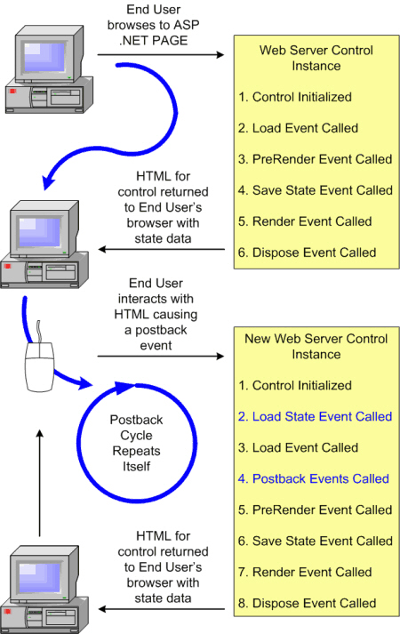
Processing of Server Controls in a Web Page (Contd.)
  The following figure shows how the Server Control is processed by the server:

Slide 10
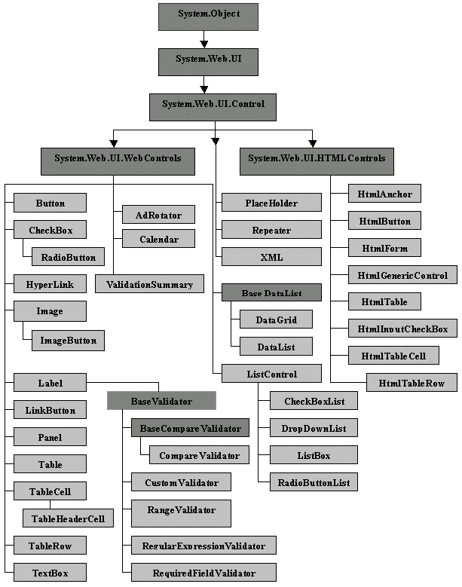
Types of Server
Controls
  The hierarchy of the Server Controls in ASP.NET is depicted in this figure:

Slide 11
Types of Server Controls (Contd.)
  The four types of Server Controls in ASP.NET are:
    ASP.NET HTML Server controls
    ASP.NET Web controls
    Validation controls
    User controls

Slide 12
Implementing HTML Server Controls
  ASP.NET HTML controls are server-side replicas of the standard HTML tags and are executed by aspnet_isapi.dll.
  To use an HTML control, import the System.Web.UI.HtmlControls namespace to a Web Form.
  The System.Web.UI.HtmlControls is derived from the HtmlControl base class.
  An example of an HTML control is HTMLInputText, which renders a text box.
  To create an HTMLInputText control, enter the following line of code in a Web Form:
  <INPUT Type = Text Runat ="server" ID = "textbox1" value ="Welcome">

Slide 13
Implementing HTML Server Controls (Contd.)
The following table lists the commonly used HTML controls with corresponding tags:
HTML server control | HTML tag
HtmlForm | <form runat=“server”>
HtmlInputText | <INPUT type = “text” runat=”server”> and <INPUT type = “password” runat=“server”>
HtmlInputCheckBox | <INPUT type=“checkbox” runat=“server”>
HtmlInputRadioButton | <INPUT type = “radio” runat=“server”>
HtmlInputImage | <INPUT type = “image” runat=“server”>

Slide 14
Implementing HTML Server Controls (Contd.)
  The following table lists the commonly used HTML controls with the corresponding
  tags: (Contd.)
HTML server control | HTML tag
HtmlAnchor | <a runat=“server”>
HtmlButton | <INPUT type=“button” runat=“server”>
HtmlTable | <table runat=“server”>
HtmlTableRow | <tr>
HtmlTableCell | <td>

Slide 15
Implementing HTML Server Controls (Contd.)
  Using HTML Server Control
    The HTML tags are used as server controls by converting them into HTML Server controls.
    The two new attributes that get added to the HTML control when it is converted to a HTML server control are:
      The id attribute: Provides a unique identifier to HTML controls for reference at the server.
      The runat attribute: Recognizes the reference as Server Control.

Slide 16
Implementing HTML Server Controls (Contd.)
  Some of the important HTML controls are as follows:
    HTMLAnchor
    HTMLInputText
    HTMLInputCheckBox
    HTMLInputRadioButton
    HTMLSelect Control

Slide 17
Implementing Web Server Controls
  Web control:
    Exist in the System.Web.UI.WebControls namespace and are derived from the WebControl base class.
    Is always closed with a trailing forward slash (/).
  The following table lists the different categories of Web Server controls:
Web Controls | Description
Basic Web controls | These are the controls that correspond to the existing HTML tags, such as TextBox, Label, Button, HyperLink, RadioButton, and CheckBox.
List controls | These are the controls used to build lists. These lists can also be bound to a data source. The controls included in this group are ListBox, DropDownList, CheckBoxList, and RadioButtonList.

Slide 18
Implementing Web Server Control (Contd.)
  The following table lists different categories of Web Server controls: (Contd.)
Web Controls | Description
Rich Web controls | These are the controls used to render an interactive calendar and to display banner advertisements. The controls in this group are Calendar and AdRotator. There are also additional controls, such as Toolbar and TreeView that belong to this category of Web controls. The Toolbar control is used to render a toolbar in client browsers, and the TreeView control is used to present hierarchical data to users in the Windows Explorer style format.
Data controls | These controls are used to display data from a database table. The controls included in this group are DataGrid, DataList, and Repeater.

Slide 19
Implementing Web Server Control (Contd.)
  Some of the most commonly used Web Server controls are:
    TextBox
    Label
    ListBox
    CheckBox and CheckBoxList
    RadioButton and RadioButtonList
    AdRotator
    Calendar
    DropDownList
    ImageButton

Slide 20
Implementing Validation Controls
  Validation controls:
    Can be attached to input controls to check the values that a user enters
    Can be used to perform tasks, such as:
      checking whether a user has entered any value for a required field
      testing the entered value against a specific value or pattern of characters
      verifying that the entered value lies within a range.
  The six validation controls in ASP.NET, are as follows:
    RequiredFieldValidator
    RegularExpressionValidator
    CompareValidator
    RangeValidator
    ValidationSummary
    CustomValidator

Slide 21
Adding Controls at Runtime
  You can add controls dynamically to a Web page.
  To add a new control to a Web page programmatically, first you require a container to hold the new control.
  There are two controls, which can be used as a container when adding such controls. They are:
    Placeholder
    Panel
  To add a control on a Web page at run time:
    Create an object of the control to be added and sets its properties.
    Then add the created control to the controls collection of container control

Slide 22
Creating Custom Controls
  Custom controls are controls that are created by combining one or more controls
  The two types of custom controls are:
    Web User Controls
    Web Custom Controls

Slide 23
Web User Controls
  Web user controls:
    Are ASP.NET pages that are converted into controls.
    Enables you to easily reuse the same content and application logic in multiple ASP.NET pages.
    Enables you to update the content easily.
  To build a Web user control, save the Web page with a .ascx extension.
  User control can be created in the similar way as an ASP.NET web form page is created.
  The difference between ASP.NET web form pages and the User controls is:
    User controls do not include <html><body> and <form runat="server"> tags within them.

Slide 24
Custom Controls
  Custom controls:
    Are compiled software components that can be created to share the same customized control among a number of ASP.NET applications.
    Can be created by using a base control class, such as the WebControl class.
    Encapsulate user interface and the application logic that is applied to the user interface into reusable packages.
    Can be accessed by placing the .dll file of the custom control in the bin directory of the Web application that will use it.
    Has to be registered by using the Register directive.

Slide 25
Handling Events in ASP.NET
  Events:
    Are generated in response to a user action.
    Are messages that contain details about the user action, which caused the event and the control on which the event occurred.
    In ASP.NET all events pass two arguments. They are:
      Object
      Event object

Slide 26
ASP.NET Server Control Event Model
    Events can be generated either on the server-side or on the client-side but the processing of the events happens only on the server.
    ASP.NET supports two types of events:
      Postback events
      Non-Postback events
    The AutoPostback property of a Web Server Control can be used to generate a postback even for a non-postback event.
    When an event is raised, then the event handler associated with that event is triggered.

Slide 27
Demonstration-Creating Web Forms using Server Controls
  Problem Statement
    Create a User control MyUserControl consisting of a TextBox and a RegularExpressionValidator control. The control should show an error message “Please enter a valid Email address” when an invalid email address is entered in the textbox.
    Use the MyUserControl that has been just created to accept the E-mail address in a form created in the Web application.

Slide 28
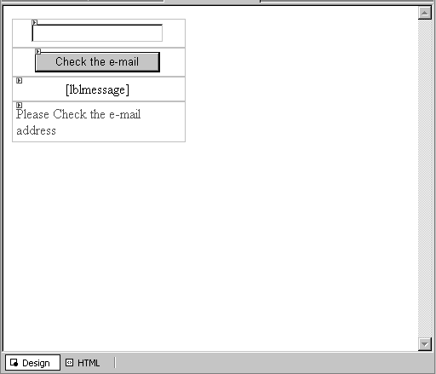
Demonstration-Creating Web Forms using Server Controls (Contd.)
  Problem Statement (Contd.)
    The design view of the user control is displayed in the following figure:

Slide 29
Demonstration-Creating Web Forms using Server Controls (Contd.)
    Solution
      Create an ASP.NET Web application.
      Design a Web User Control.
      Register the Web User Control.
      Run the application.

Slide 30
Summary
  Server controls are components, which can be rendered as markup text on a Web browser and are capable of executing program logic on the server.
  The steps in processing a server control are:
    Initialization
    Loading
    PreRendering
    Saving State
    Rendering
    Dispose
    Unloading

Slide 31
Summary (Contd.)
  The four types of server controls in ASP.NET are:
    ASP.NET HTML server controls
    ASP.NET Web controls
    Validation controls
    User controls
  A HTML tag can be converted into HTML server control by right-clicking the control and selecting Run As Server control.
  Commonly used HTML server controls include:
    HTMLAnchor control
    HTMLInputText control
    HTMLCheckBox control
    HTMLInputRadioButton control
    HTMLSelect control

Slide 32
Summary (Contd.)
    The different categories of Web server controls available in ASP.NET are:
      Basic Web controls
      List controls
      Rich Web controls
      Data controls
    Commonly used Web server controls are:
      TextBox control
      List control
      ListBox control
      Checkbox control
      CheckBoxList control
      RadioButton control
      Calendar control
      AdRotator control

Slide 33
Summary (Contd.)
      Toolbar control
      TreeView control
      DataGrid control
      DataList control
      Repeatar control
    ASP.NET supports six types of Validation controls:
      RequiredFieldValidator
      RegularExpressionValidator
      CompareValidator
      RangeValidator
      ValidationSummary
      CustomValidator

Slide 34
Summary (Contd.)
    ASP.NET supports two types of custom controls:
      Web User controls
      Web Custom controls
    Events are messages that contain details about the user action, which caused the event and the control on which the event occurred.
    ASP.NET supports two types of events:
      Postback events
      Non-Postback events

